Slide 1
Digital VIDEO PROCESSING

Slide 2
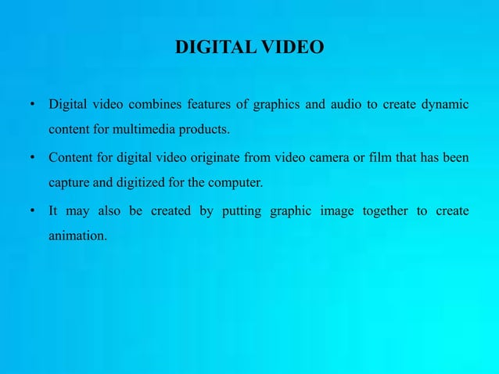

Slide 3
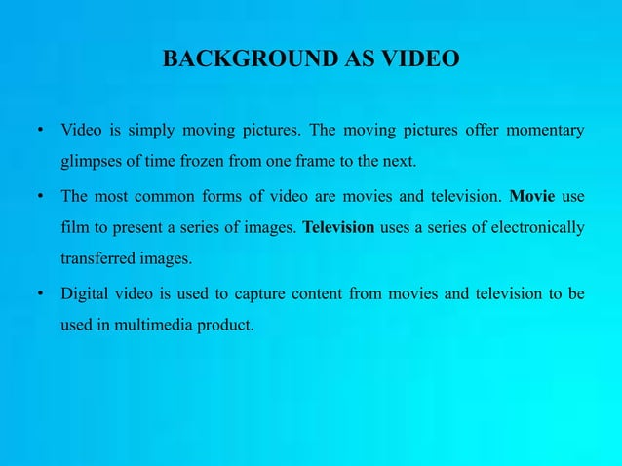

Slide 4
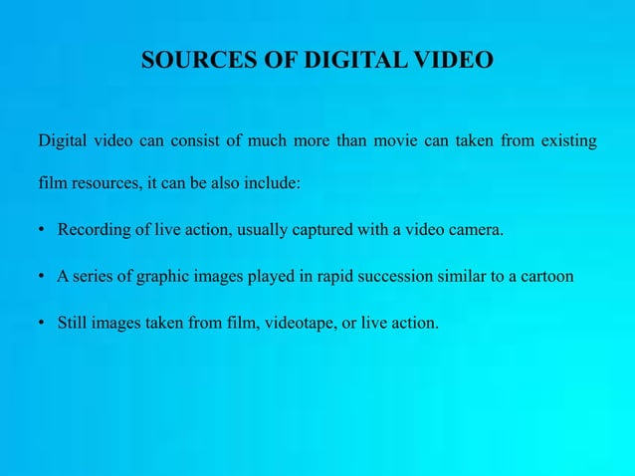

Slide 5
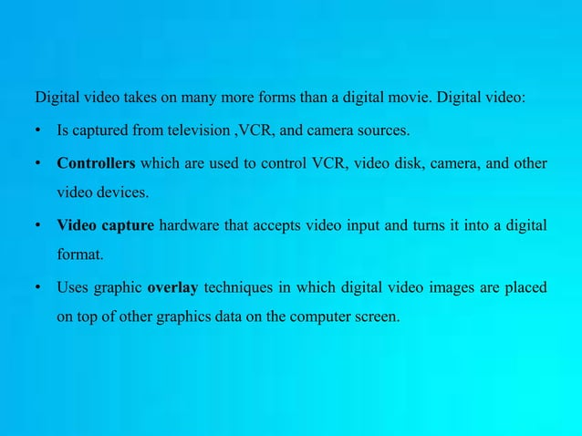

Slide 6
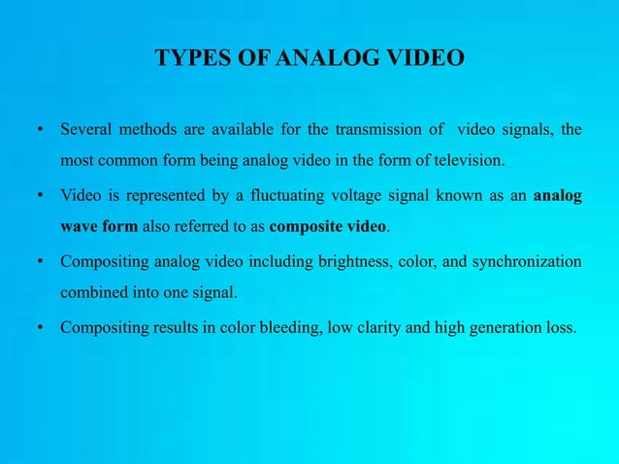

Slide 7
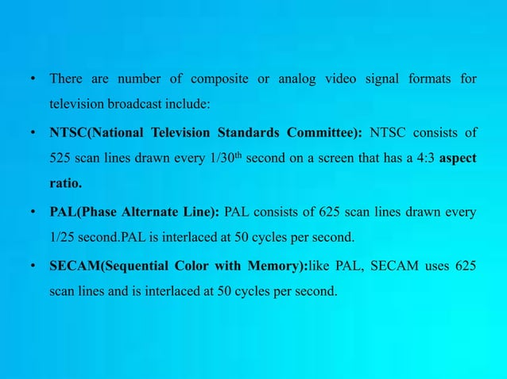

Slide 8
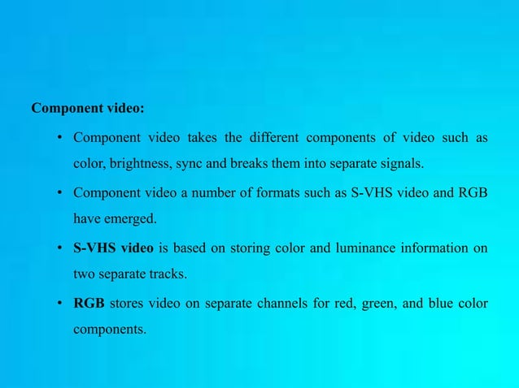

Slide 9
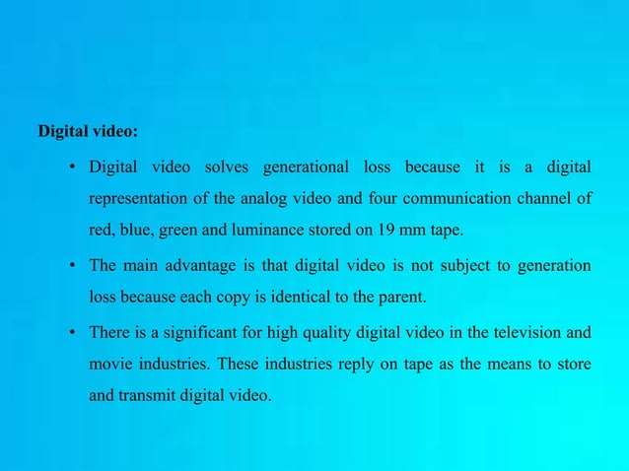

Slide 10
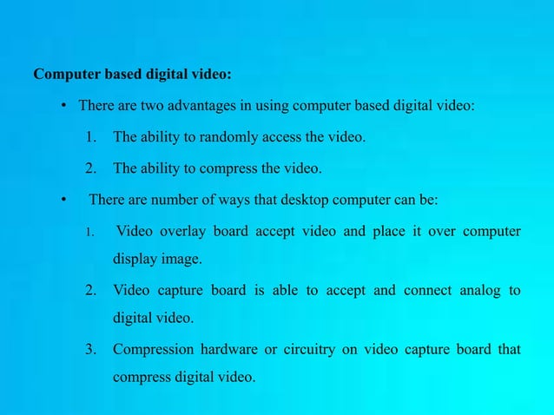

Slide 11
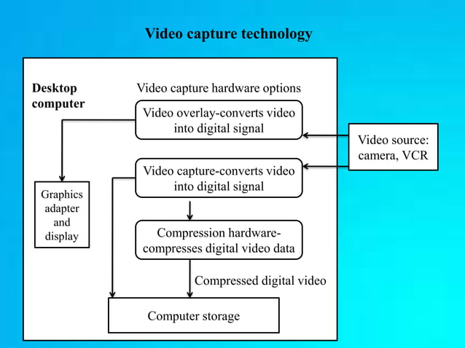

Slide 12
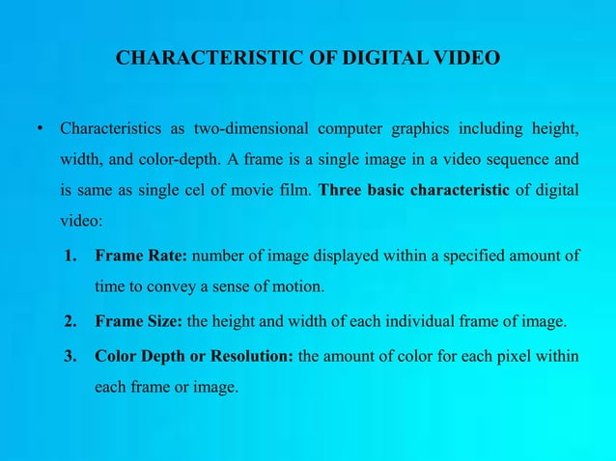

Slide 13
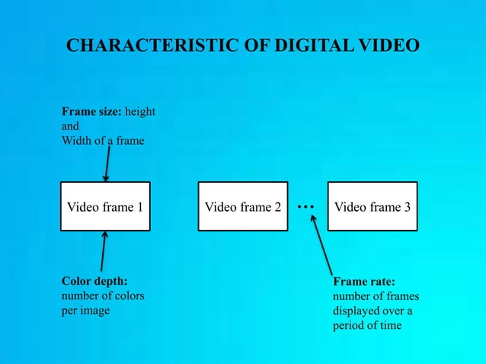

Slide 14
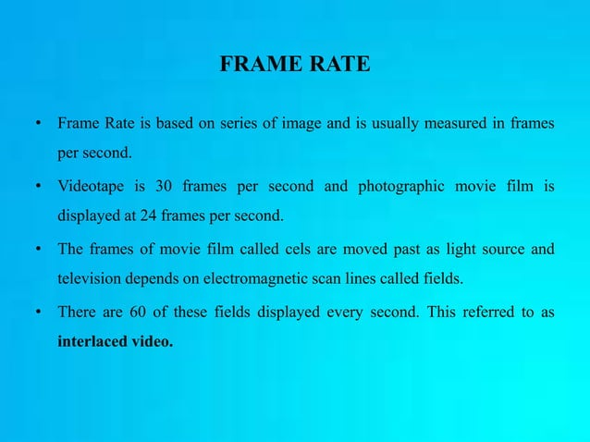

Slide 15
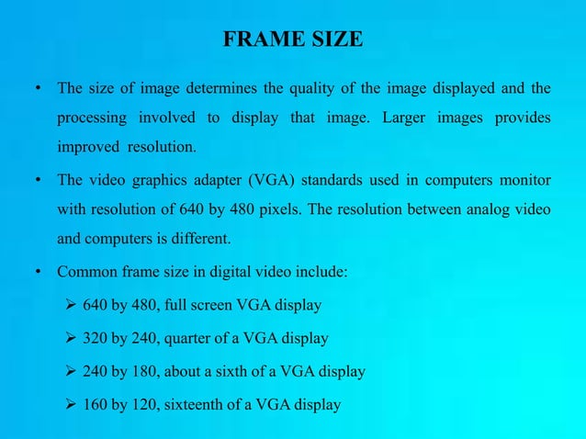

Slide 16
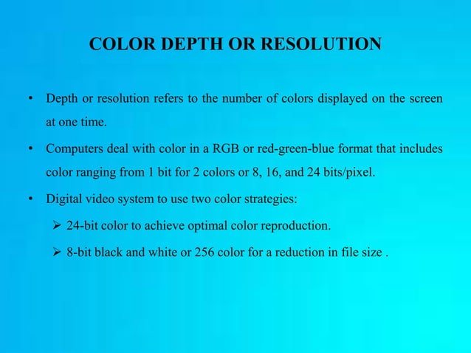

Slide 17
Video Signal
Video signal is basically any sequence of time varying images.
A still image is a spatial distribution of intensities that remain constant with time, whereas a time varying image has a spatial intensity distribution that varies with time.
Video signal is treated as a series of images called frames. An illusion of continuous video is obtained by changing the frames in a faster manner which is generally termed as frame rate.

Slide 18
I,P,B Frames
Frames between two successive ‘I’ frames, including the leading ‘I’ frame, are collectively called as group of pictures (GOP).
The GOP is illustrated in figure 3. The illustrated figure has one ‘I’ frame, two ‘P’ frames and six ‘B’ frames.
Typically, multiple ‘B’ frames are inserted between two consecutive ‘P’ or between ‘I’ and ‘P’ frames.
The existence of GOPs facilitates the implementation of features such as random access, fast forward or fast and normal reverse playback

Slide 19
I,P,B Frames
Three types of video frames are I-frame, P-frame and B-frame.
‘I’ stands for Intra coded frame,
‘P’ stands for Predictive frame and
‘B’ stands for Bidirectional predictive frame.
‘I’ frames are encoded without any motion compensation and are used as a reference for future predicted ‘P’ and ‘B’ type frames. ‘I’ frames however require a relatively large number of bits for encoding.
‘P’ frames are encoded using motion compensated prediction from a reference frame which can be either ‘I’ or ‘P’ frame.
‘P’ frames are more efficient in terms of number of bits required compared to ‘I’ frames, but still require more bits than ‘B’ frames.
‘B’ frames require the lowest number of bits compared to both ‘I’ and ‘P’ frames but incur computational complexity.

Slide 20
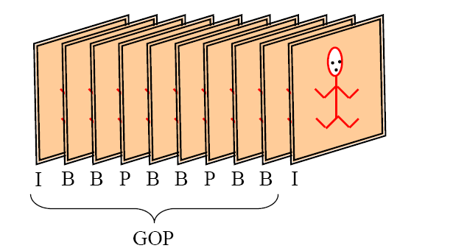
Frame Types (GOP)

Slide 21
Video Cameras
Tube based Imagers, Vidicons, Plumbicons or Orthicons
Solid State sensors such as CCD

Slide 22
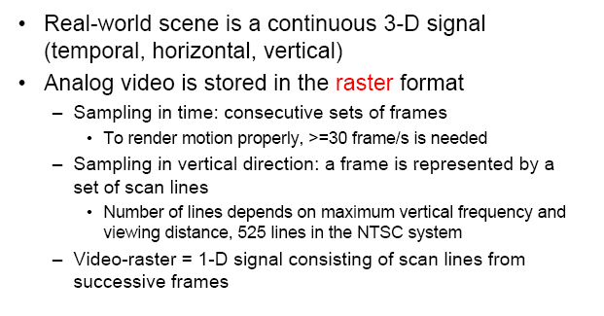
Raster Scan

Slide 23
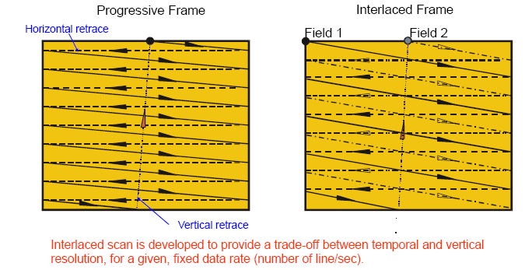
Progressive and Interlaced Scans

Slide 24
Progressive and Interlaced Scans
Progressive scan patterns are used for high resolution displays like computer CRT monitors Digital cinema projections.
In progressive scan, each frame of picture information is scanned completely to create the video signal.
In interlaced scan pattern, the odd and even lines of each picture are read out in two separate scans of the odd and even fields respectively.
This allows good reproduction of movement in the scene at relatively low field rate.

Slide 25
Characterization of Video Raster
Temporal - Frame rate = frames/sec = fs,t -
Vertical -Line number = lines/frame = fs,y
Line rate = lines/second = fl = fs,t * fs,y
Frame interval =
Vertical sampling rate =
Time interval =

Slide 26
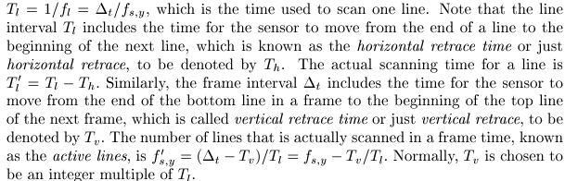
Characterization of Video Raster

Slide 27
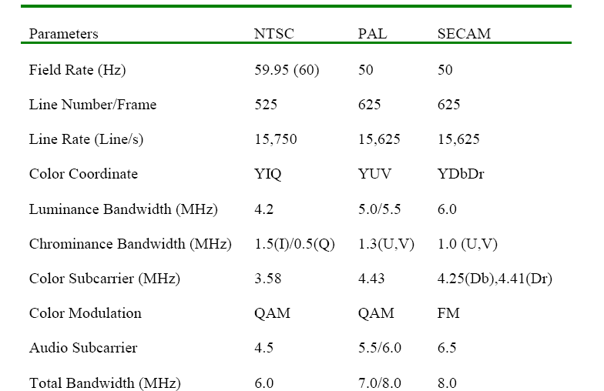
Different Color TV Systems

Slide 28
Digital Video
In a digital video, the picture information is digitized both spatially and temporally and the resultant pixel intensities are quantized.
The demand for digital video is increasing in areas such as video teleconferencing, multimedia authoring systems, education, and video-on-demand systems.

Slide 29
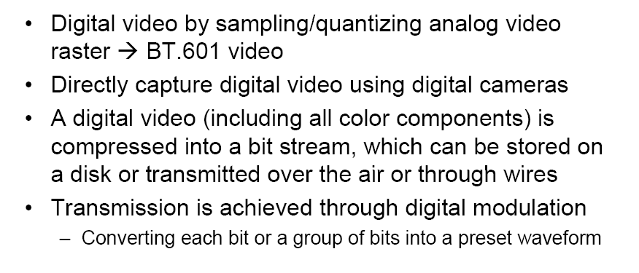
Digital Video

Slide 30
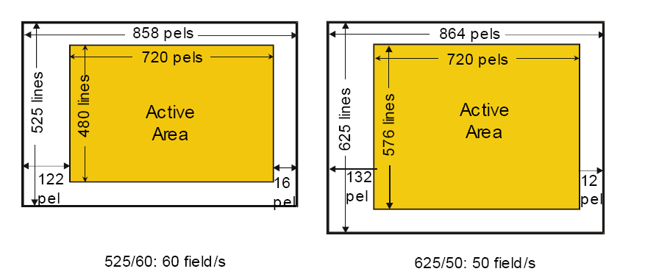
BT.601* Video Format (commonly known as SDTV)

Slide 31
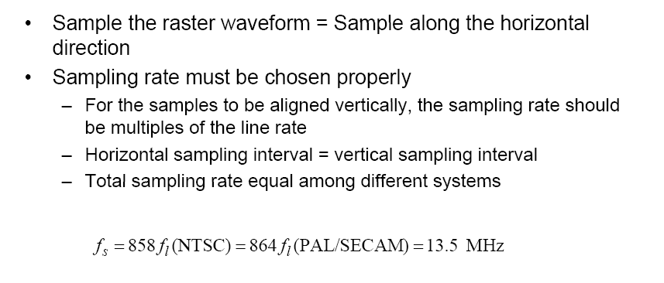
Digitizing The raster Video

Slide 32
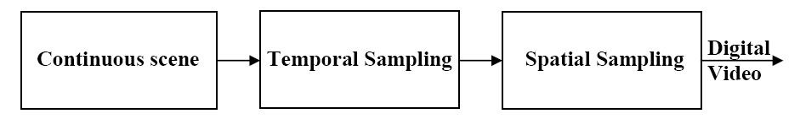
Digital Video

Slide 33
Digital Video Sampling
Spatial Sampling
The sensitivity of Human Visual System (HVS) varies according to the spatial frequency of an image.
In the digital representation of the image, the value of each pixel needs to be quantized using some finite precision.
In practice, 8 bits are used per luminance sample.
Temporal sampling
A video consists of a sequence of images, displayed in rapid succession, to give an illusion of continuous motion.
If the time gap between successive frames is too large, the viewer will observe jerky motion.
The sensitivity of HVS drops off significantly at high frame rates.
In practice, most video formats use temporal sampling rates of 24 frames per second and above.

Slide 34
Video Formats
Digital video consists of video frames that are displayed at a prescribed frame rate.
A frame rate of 30 frames/sec is used in NTSC video. The frame format specifies the size of individual frames in terms of pixels.
The Common Intermediate Format (CIF) has 352 x 288 pixels, and
the Quarter CIF (QCIF) format has 176 x 144 pixels.
Each pixel is represented by three components: the luminance component Y, and the two chrominance components Cb and Cr.

Slide 35
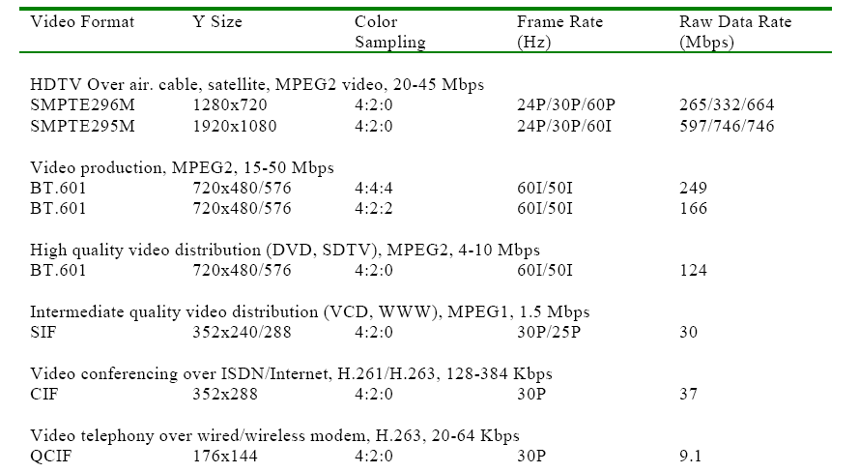
Digital Video Formats

Slide 36
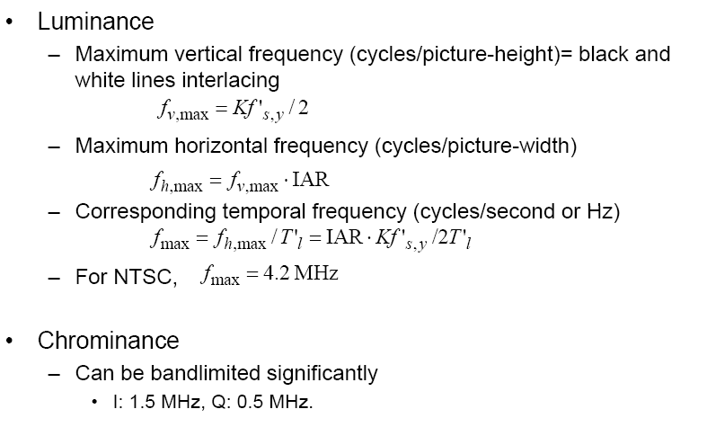
TV signal bandwidth

Slide 37
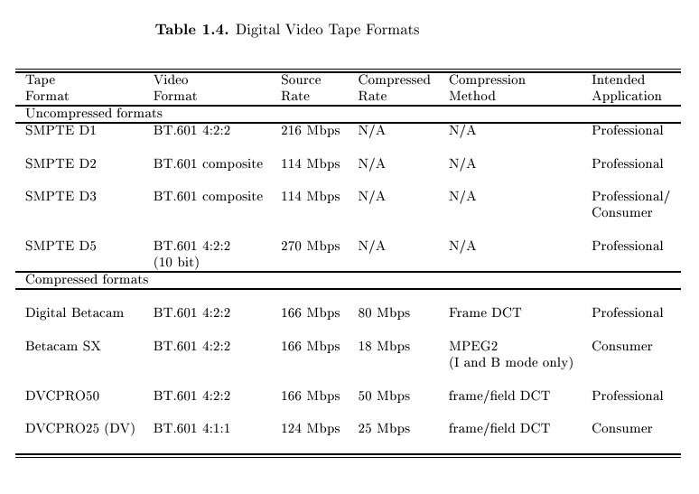
Digital Video Tape Formats

Slide 38



Digital Quality Measures

Slide 39
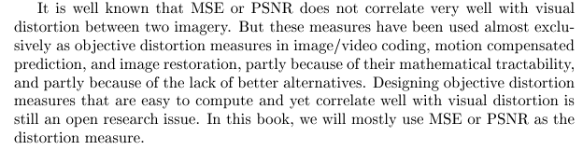
Digital Quality Measures

